Slide 1
Parameter Estimation
25 June 2020
for Invasive Aspergillosis in silico Model
Name: Jiujia Zhang
CID: 01203777

Slide 2
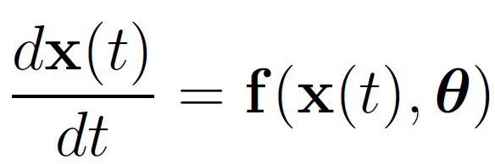
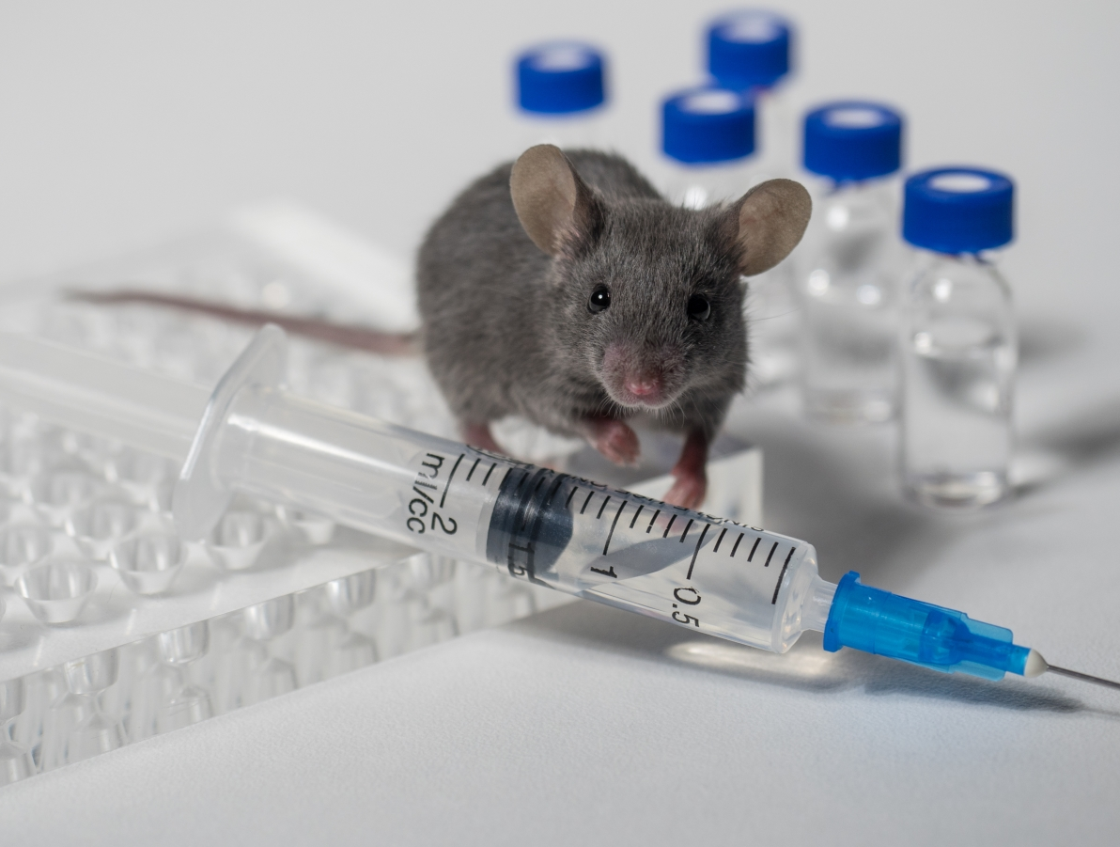
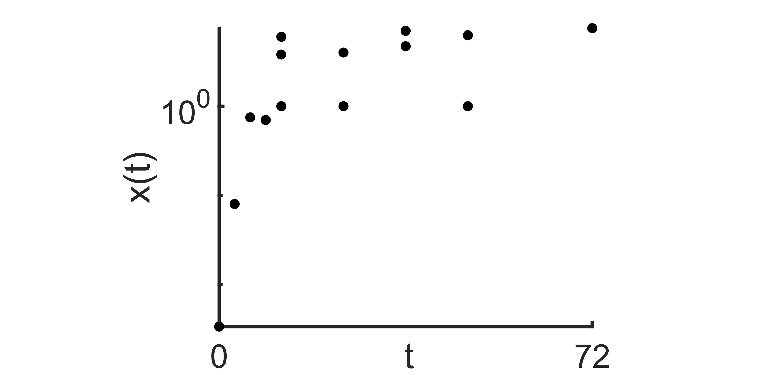
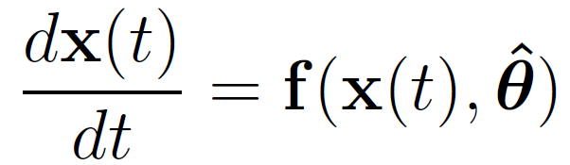
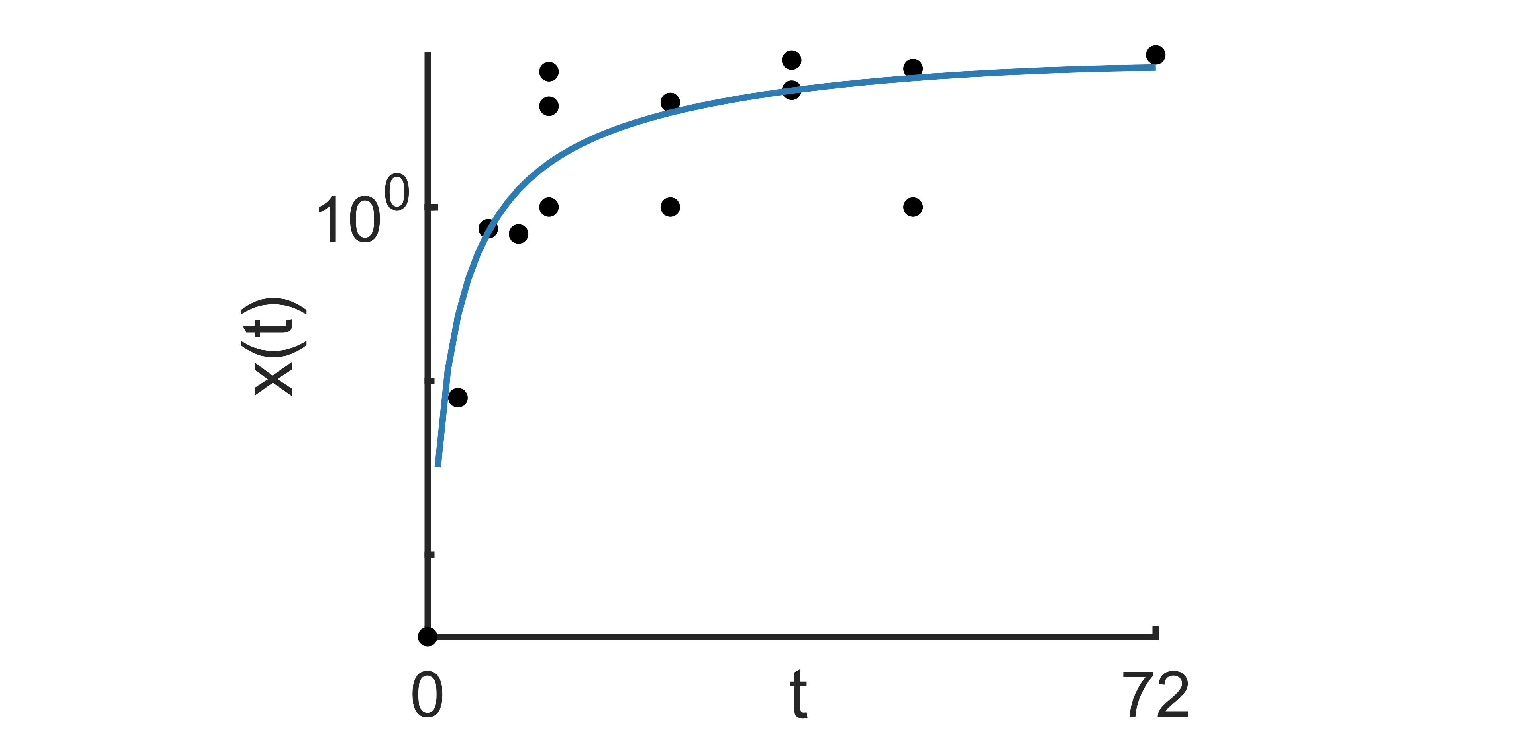

Systems Immunology:
Background
Mathematical
Model
Experiment
Experimental
Data
Fitted Model
Parameter Estimation
1/9

Slide 3
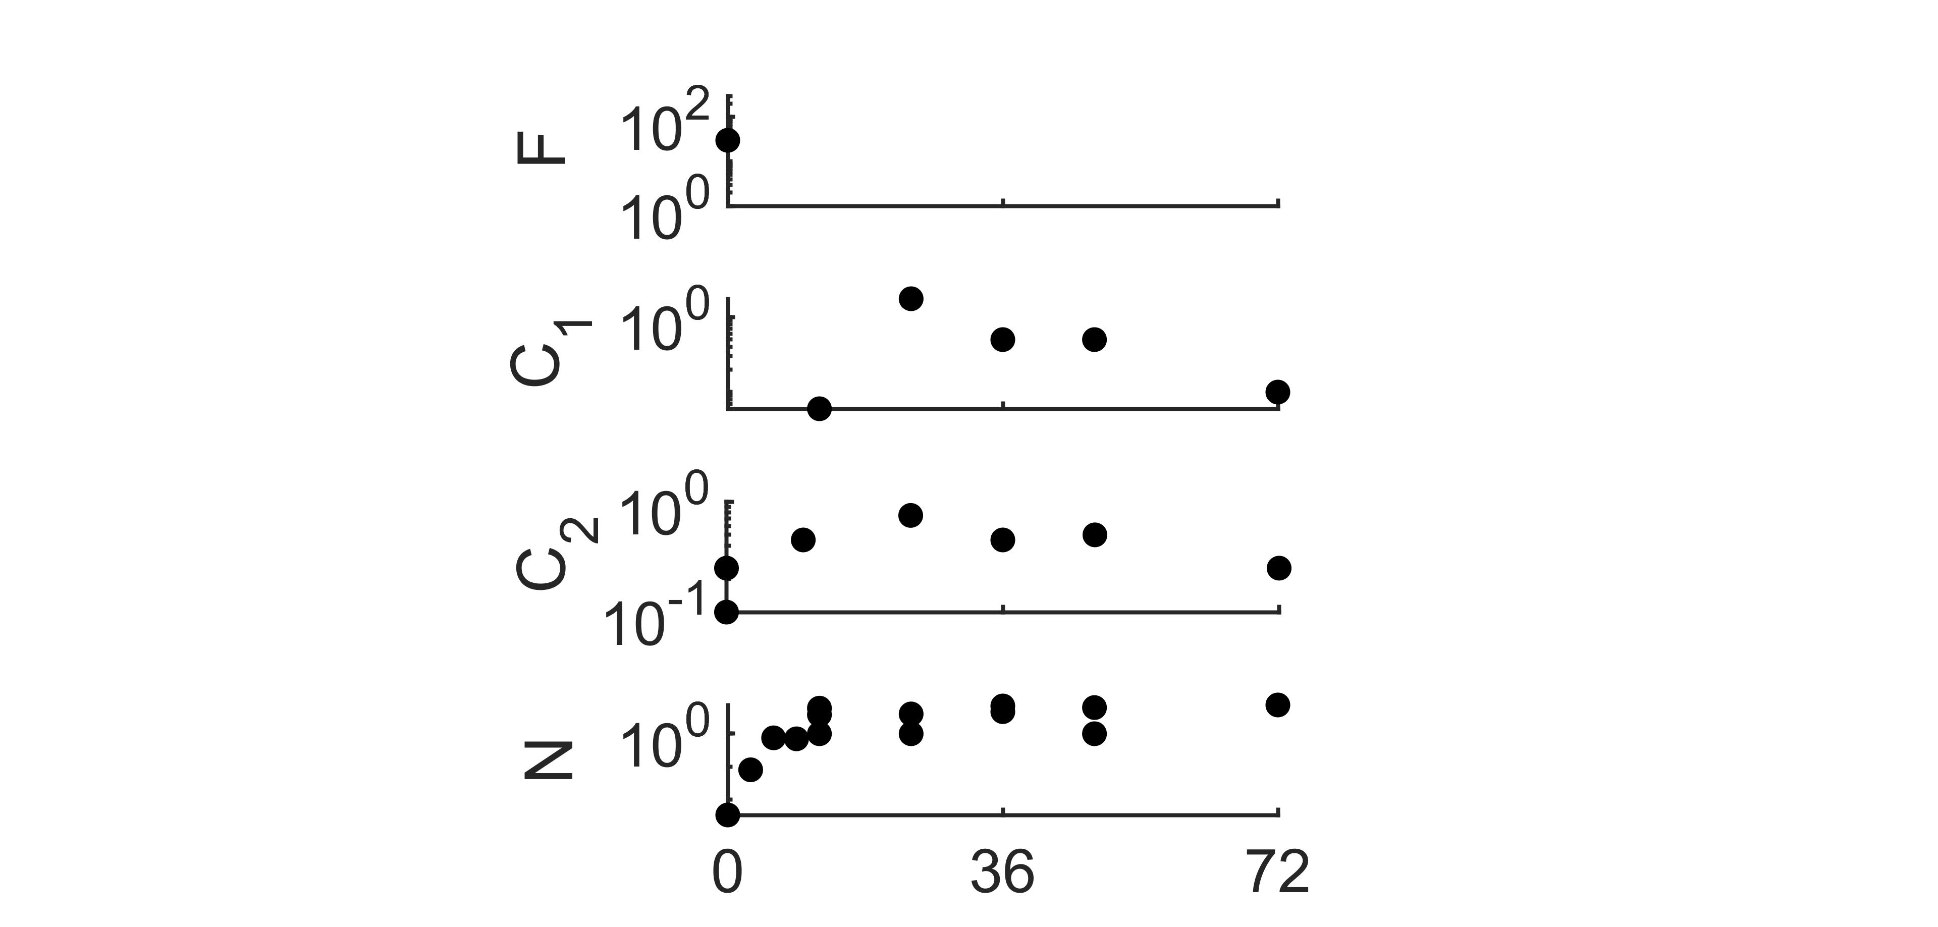
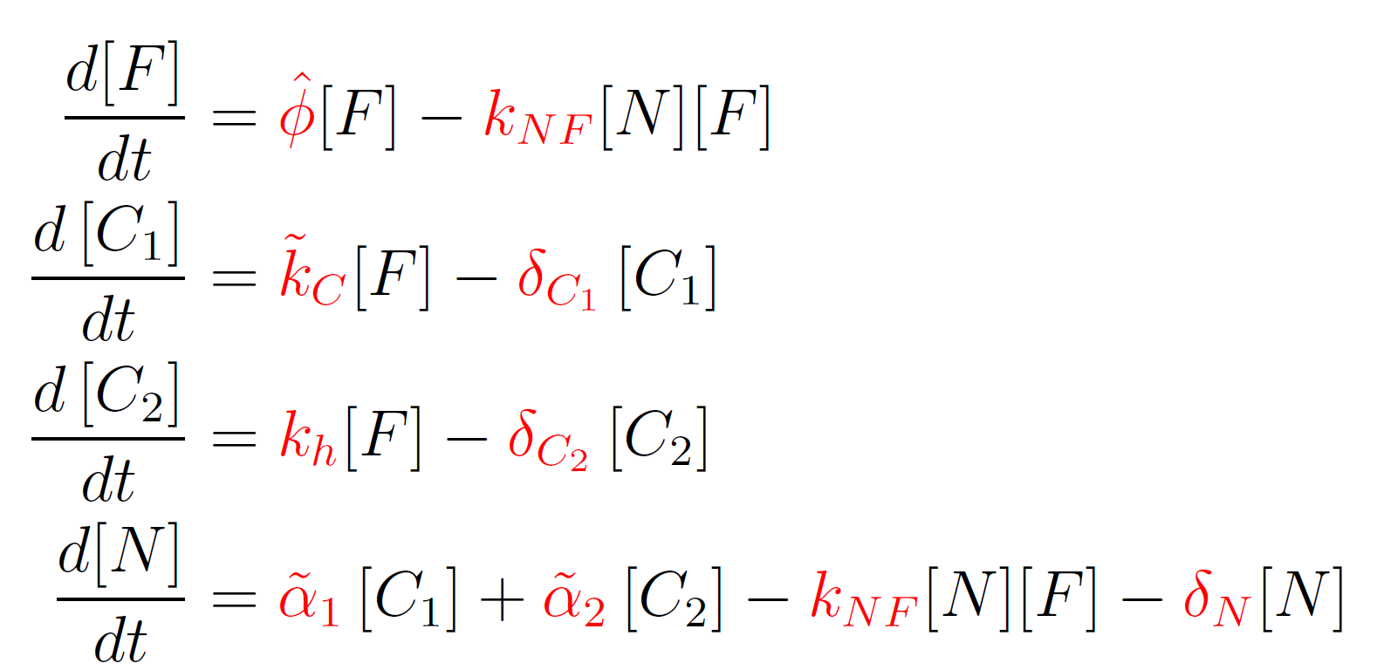
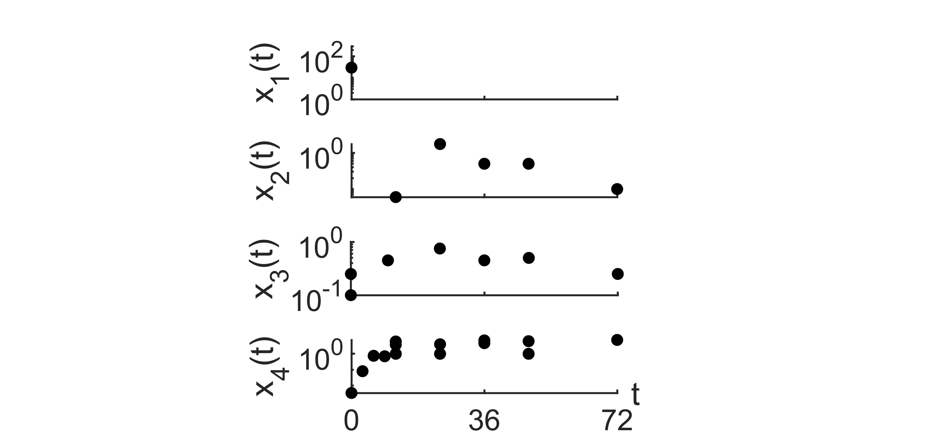
Challenges in Parameter Estimation:
Background
Experimental Data:
Invasive Aspergillosis Model:
Data Feature:
Sparsity
Latency
2/9

Slide 4
Challenges in Parameter Estimation:
Background
Experimental Data:
Invasive Aspergillosis Model:
Data Feature:
Sparsity
Latency
2/9

Slide 5
Aim and Objectives:
Project Aim
Aim:
Achievability of Parameter Estimation with Sparse and Latent Data
Objectives:
Simulation study
Identify problems that impede parameter estimation
Propose alternative strategies
3/9

Slide 6
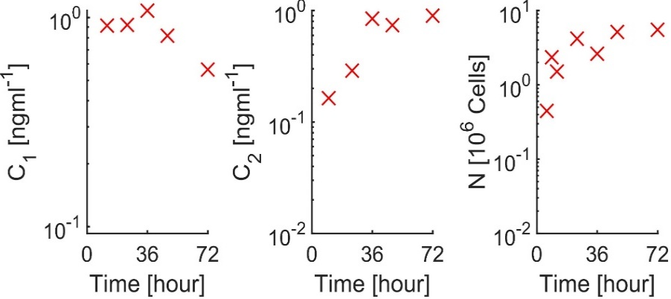
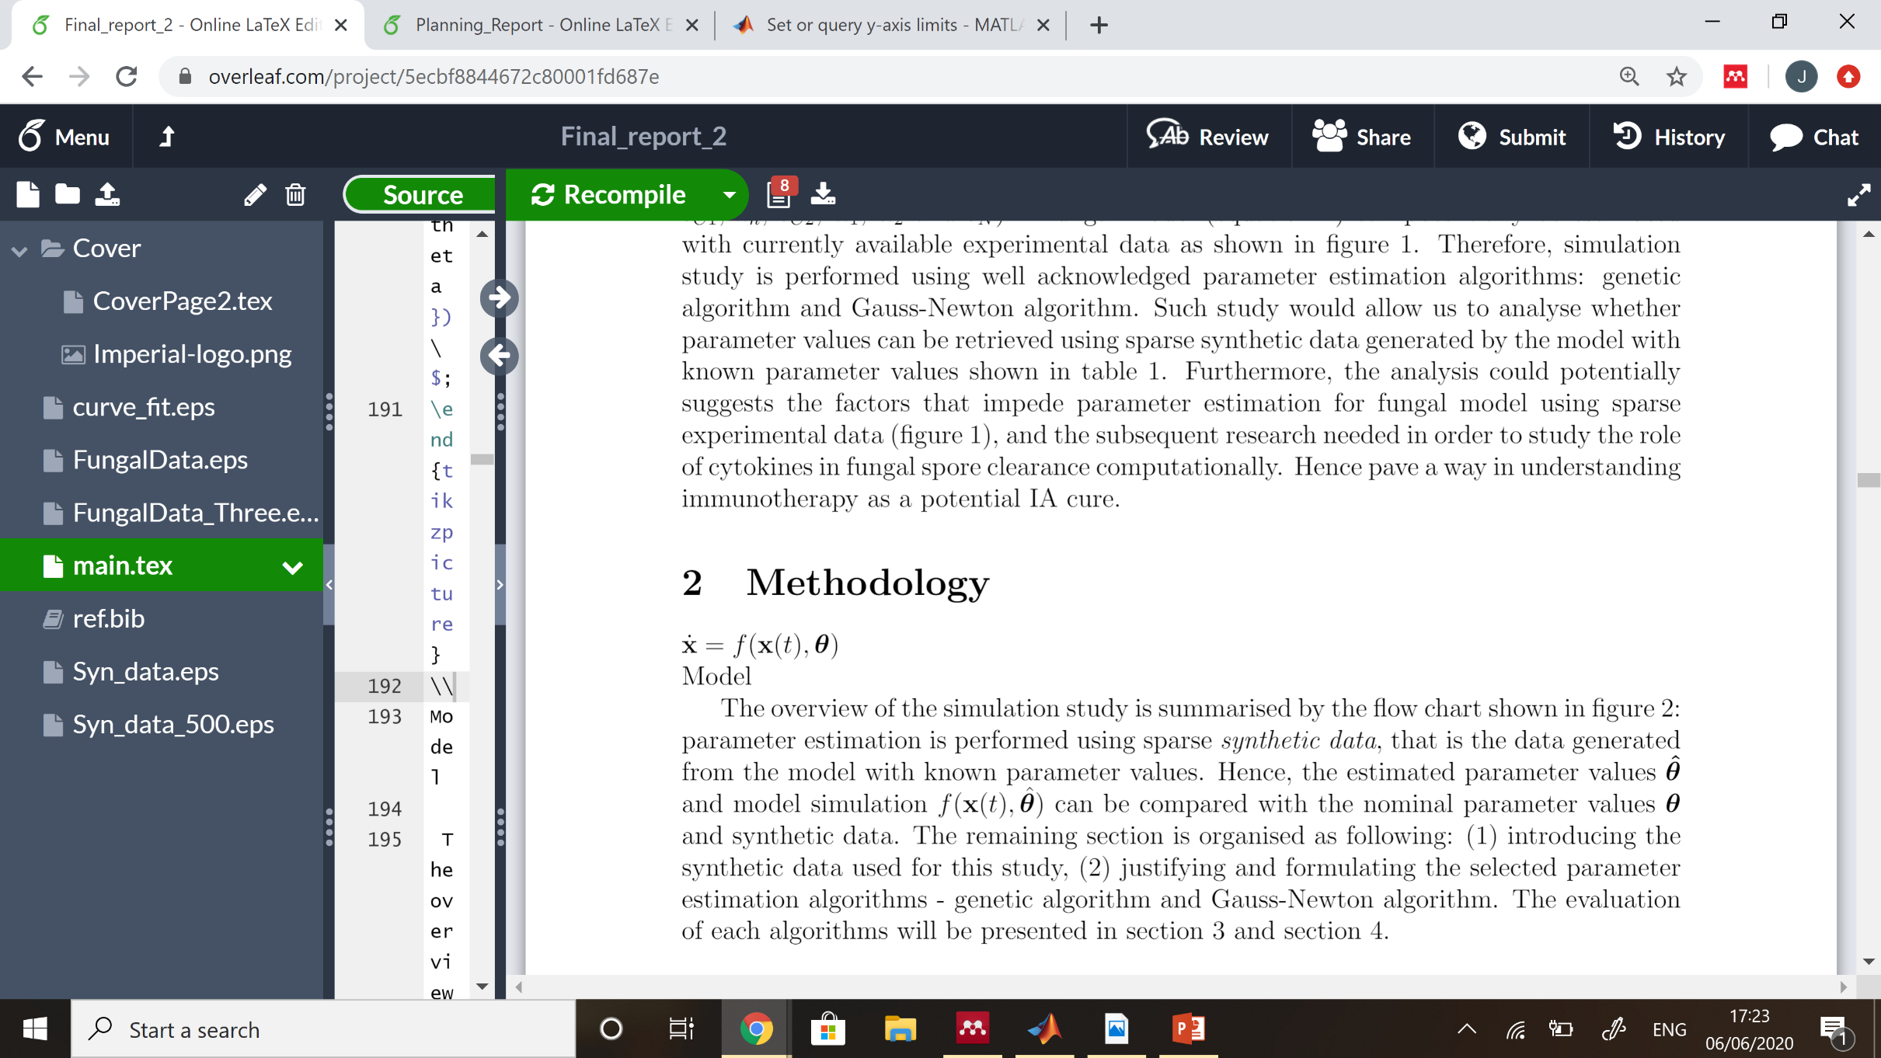
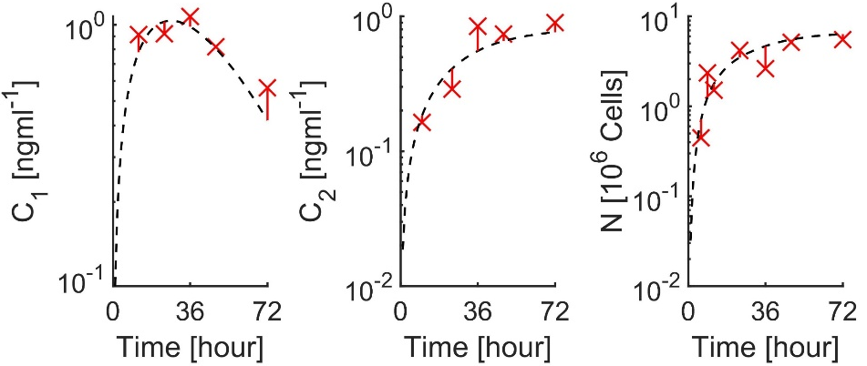

Methodology:
Methodology
Synthetic data
Estimated Parameter
Parameter Estimation
$$\hat{θ}$$
4/9

Slide 7
Methodology:
Methodology
Synthetic data
Estimated Parameter
Parameter Estimation
$$\hat{θ}$$
4/9

Slide 8
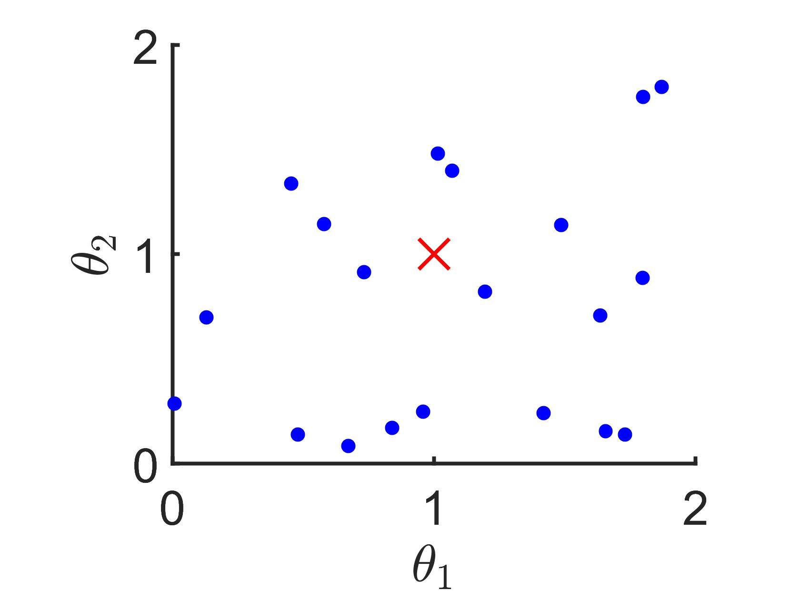
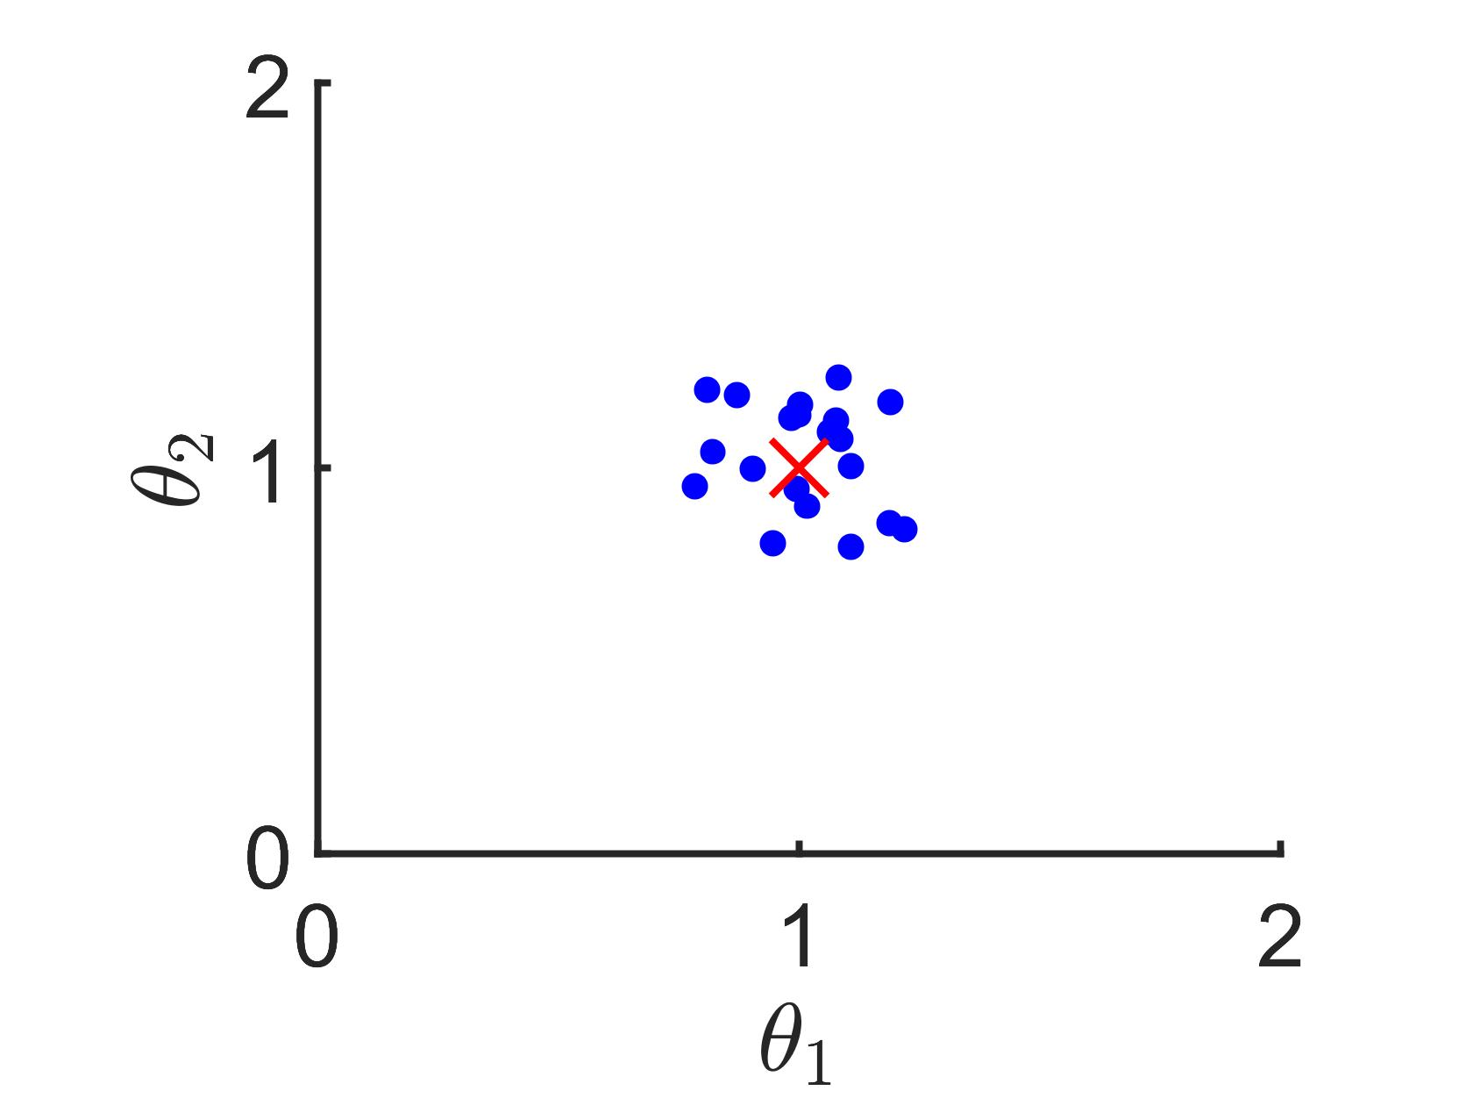
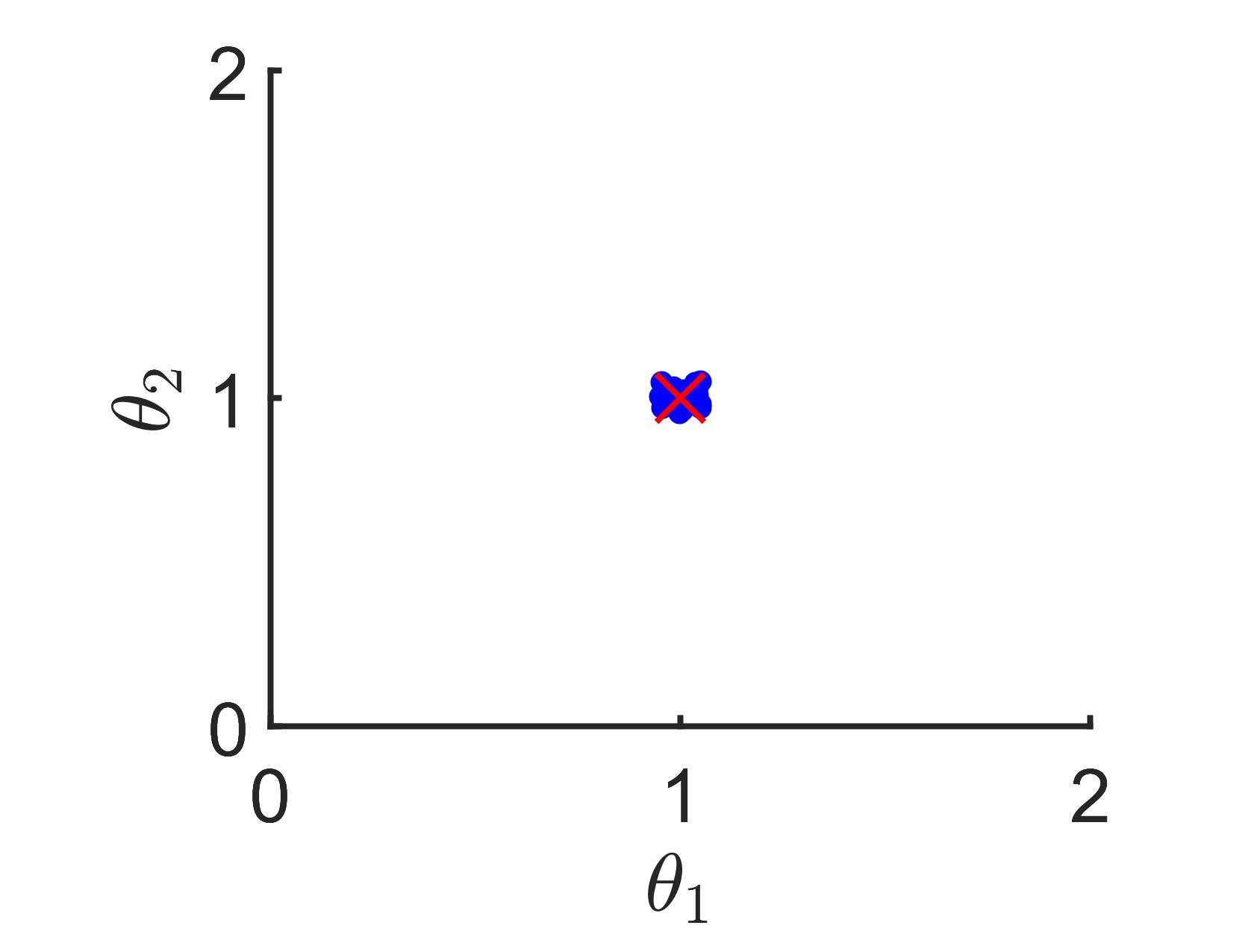
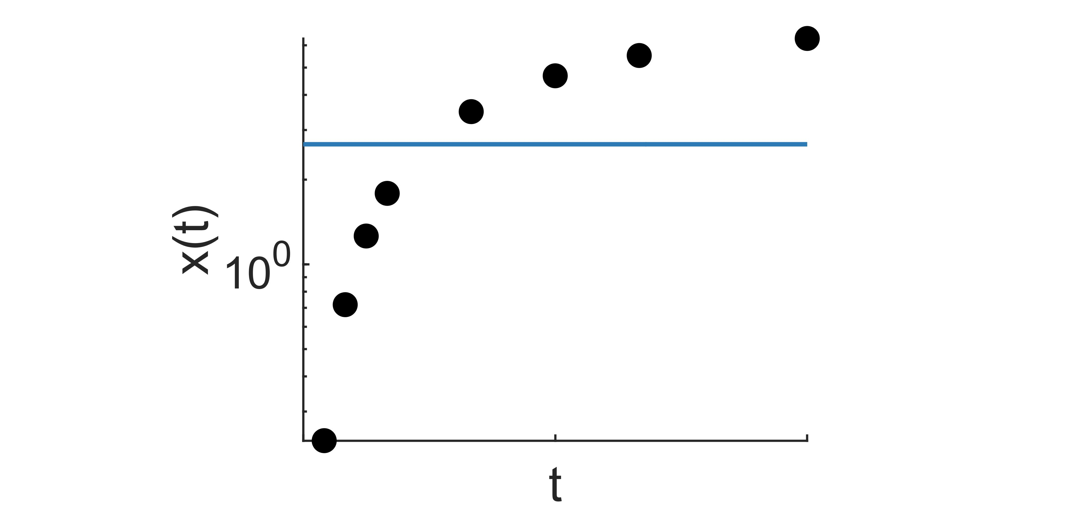
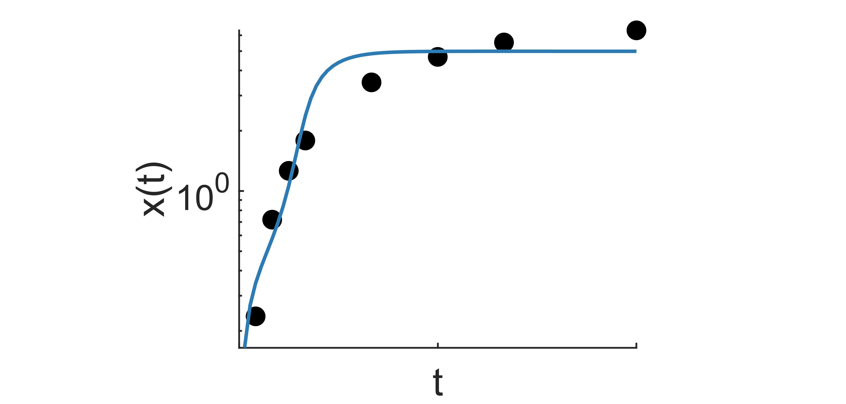
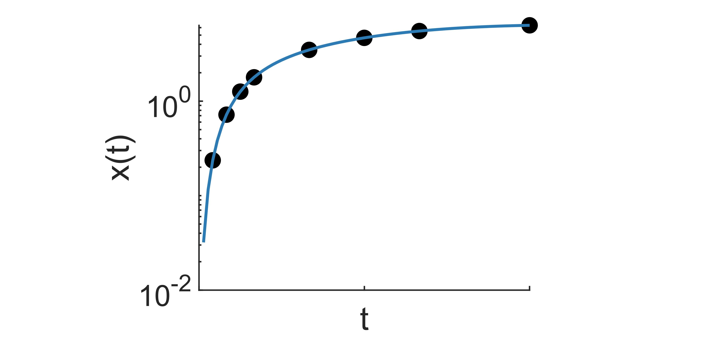
Genetic Algorithm:
Methodology
Darwinian evolutionary theory: Survival of the fittest
Parameter Population:
Example
Model Simulation:
5/9

Slide 9
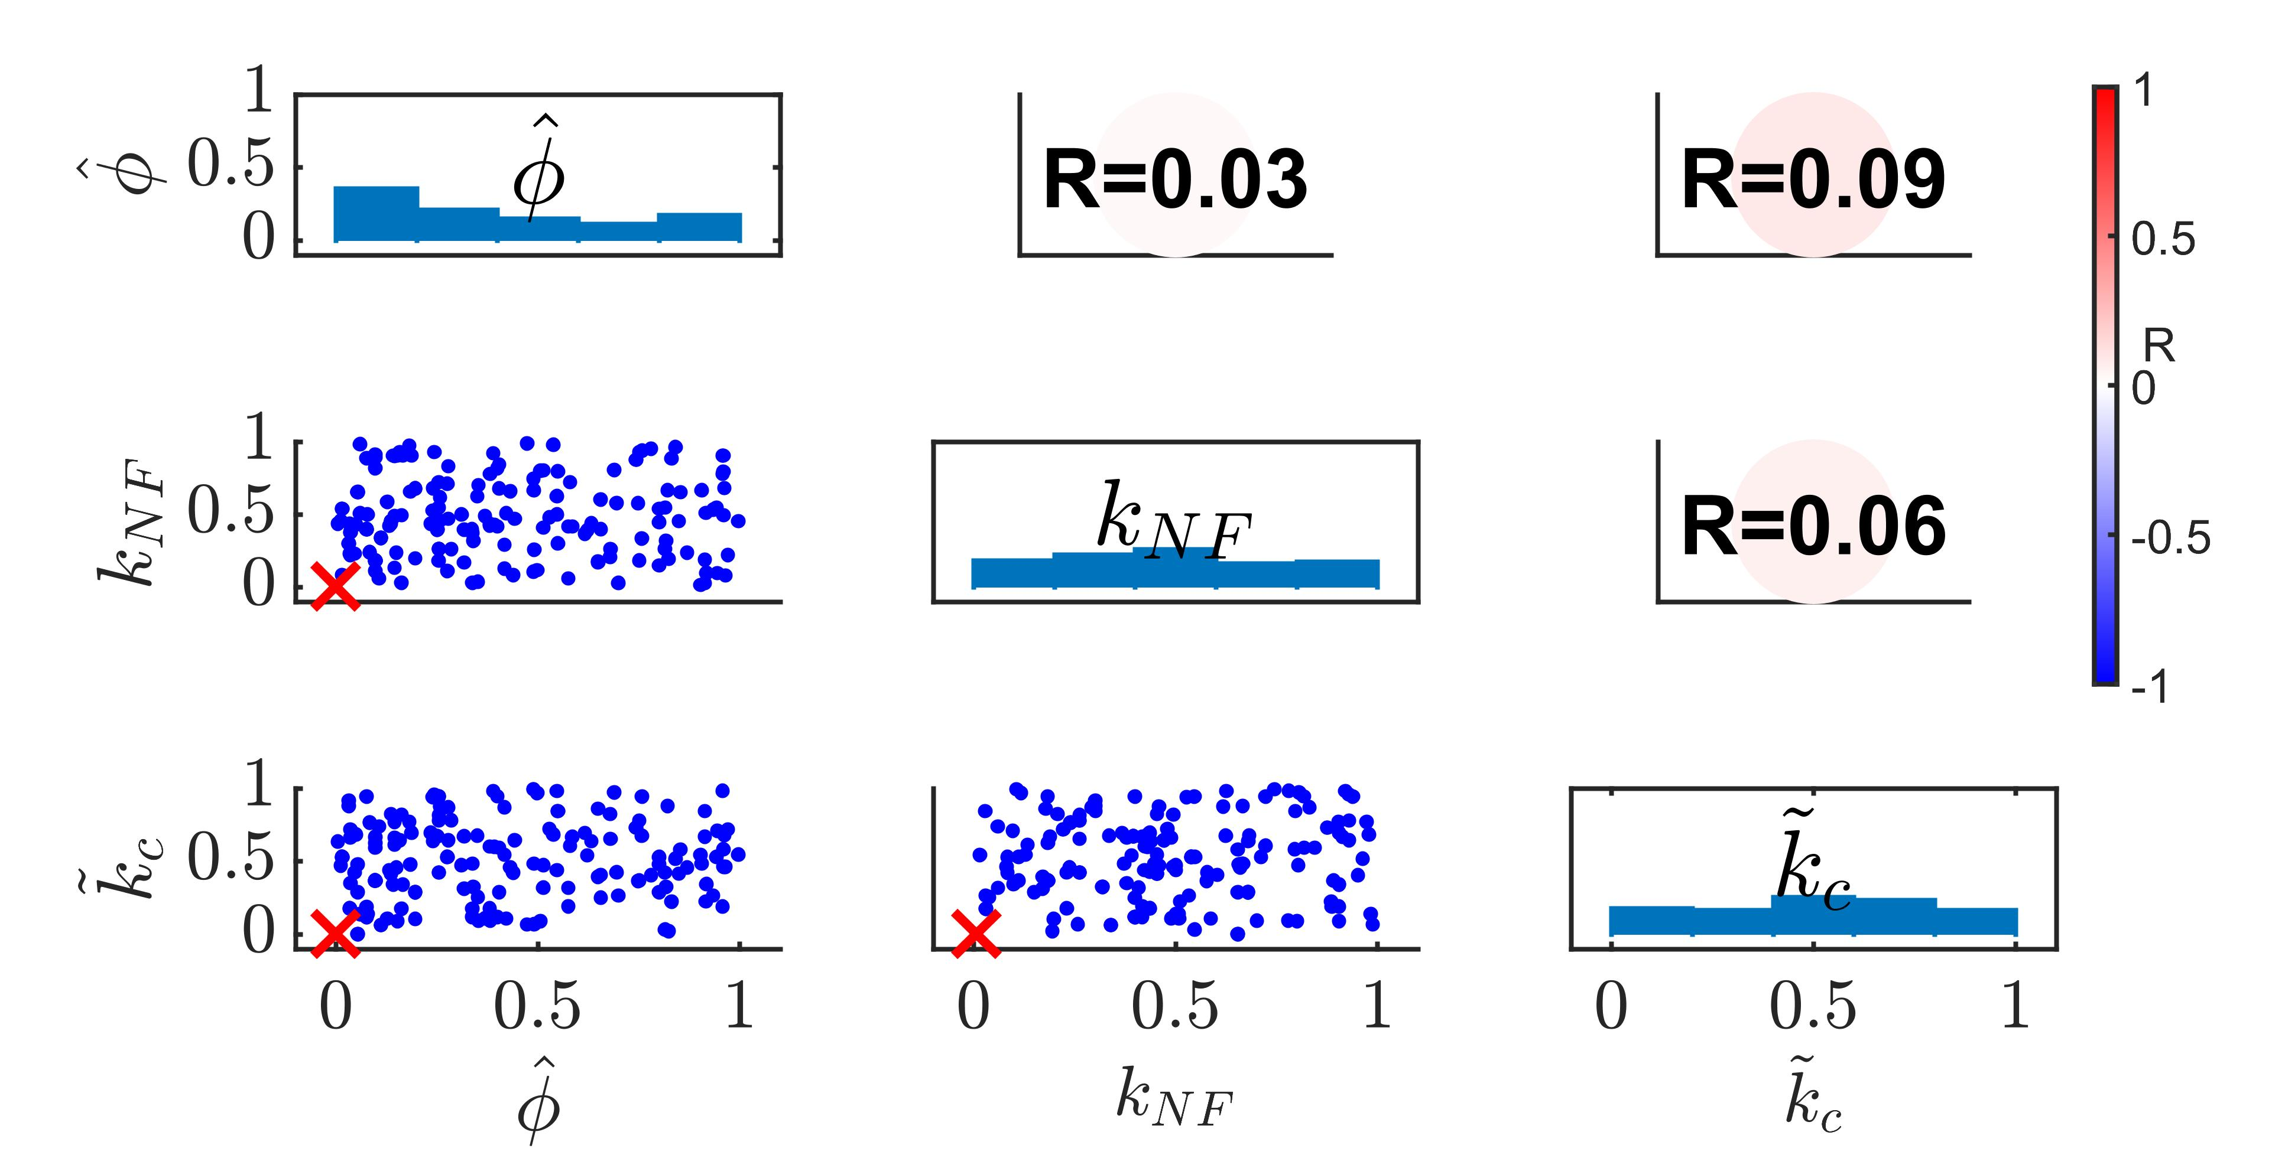
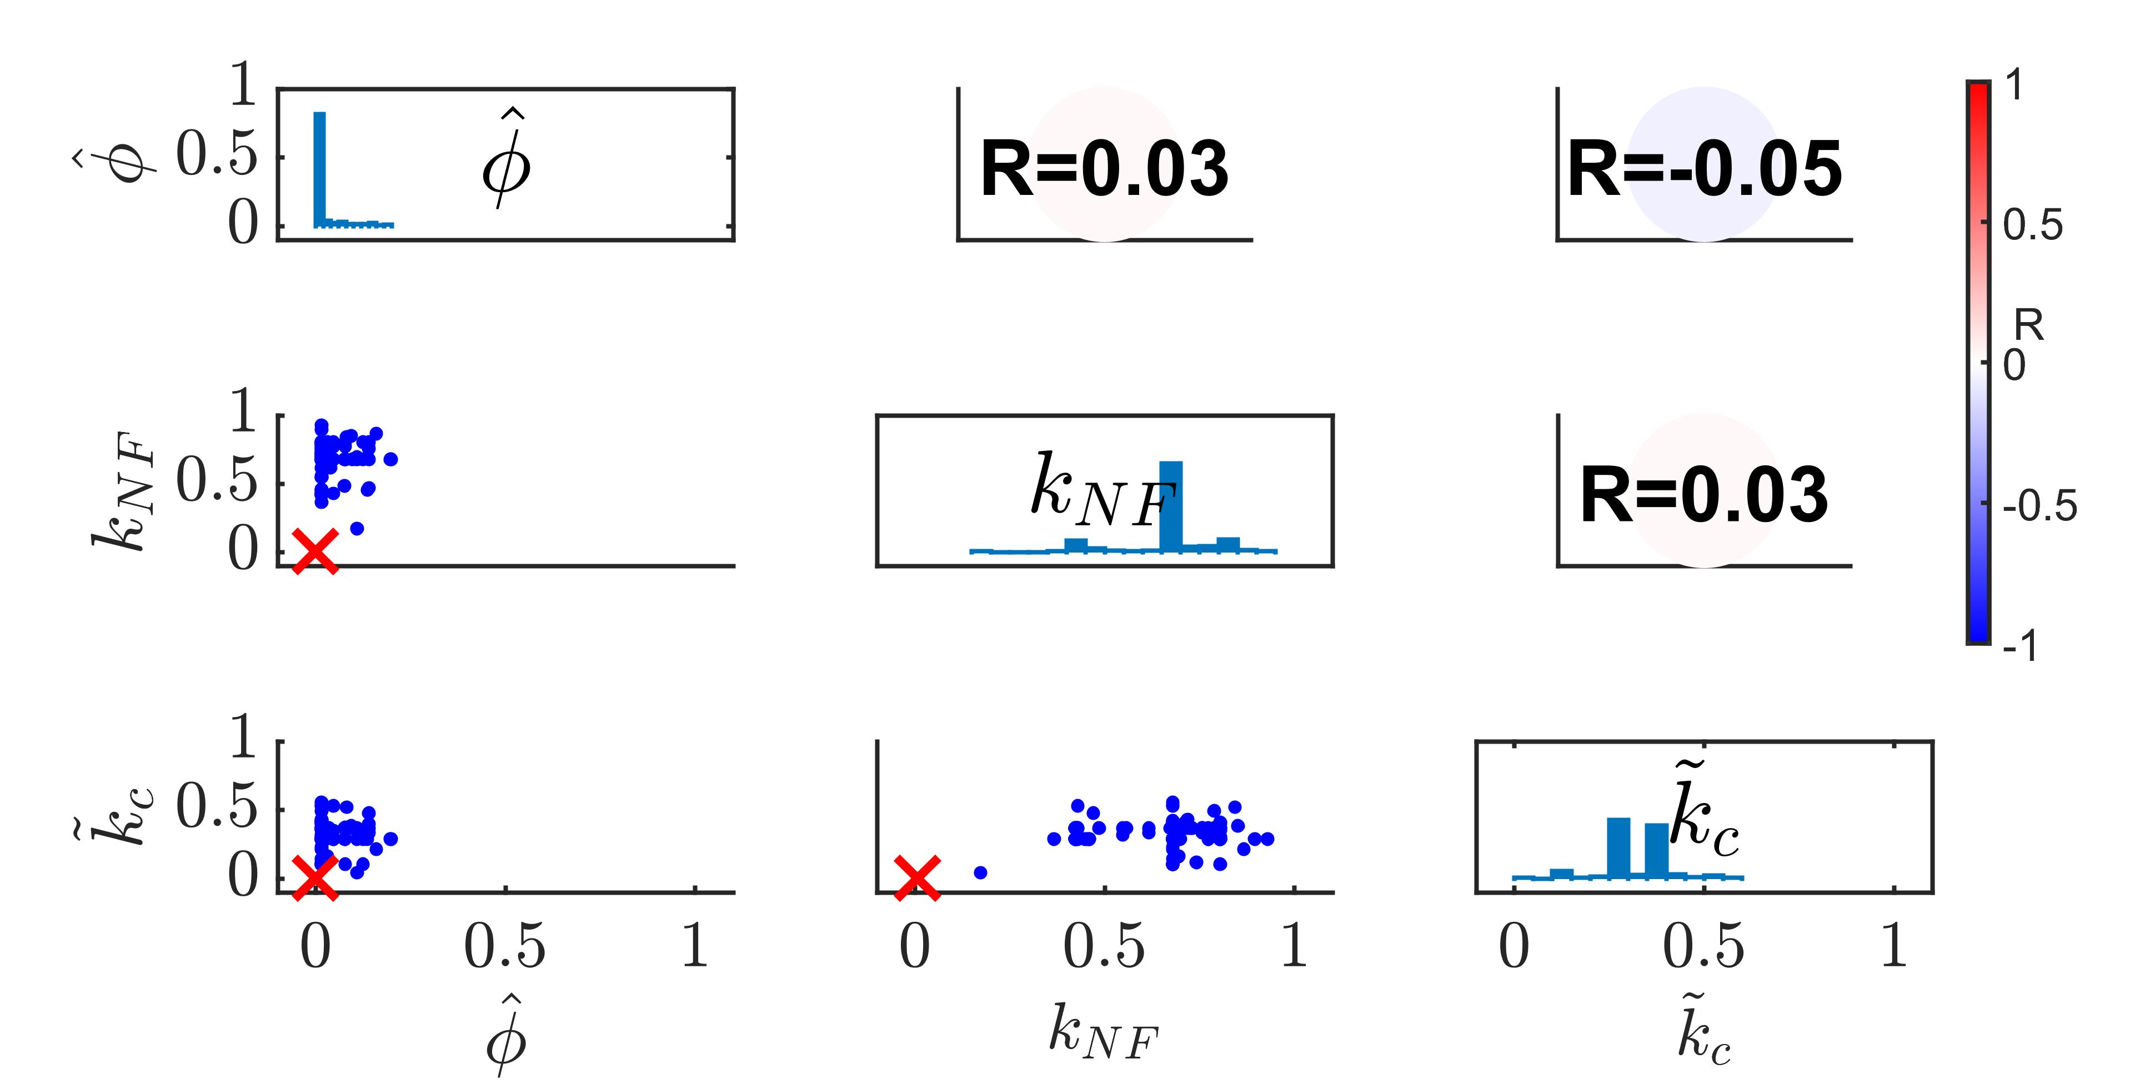
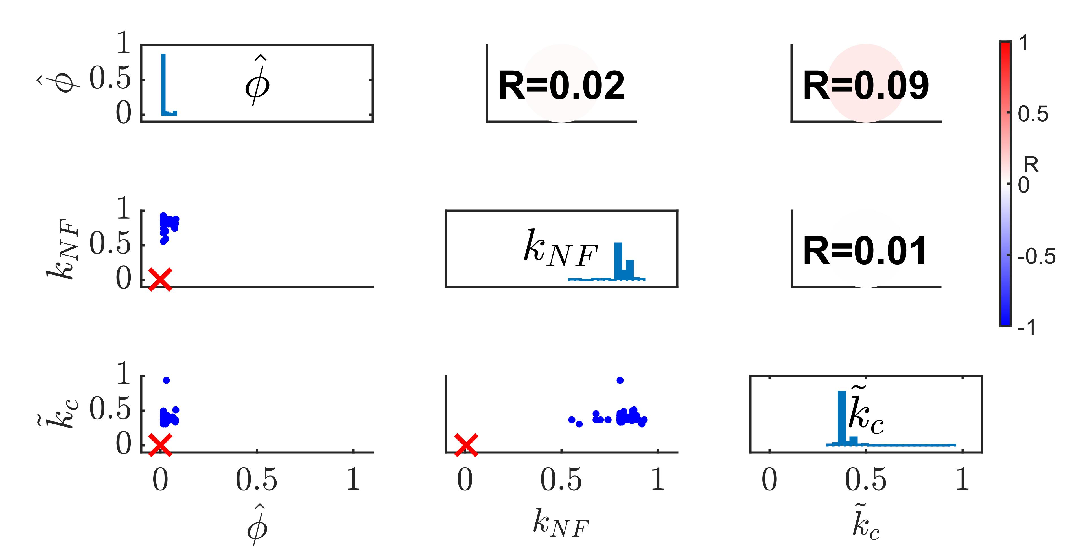
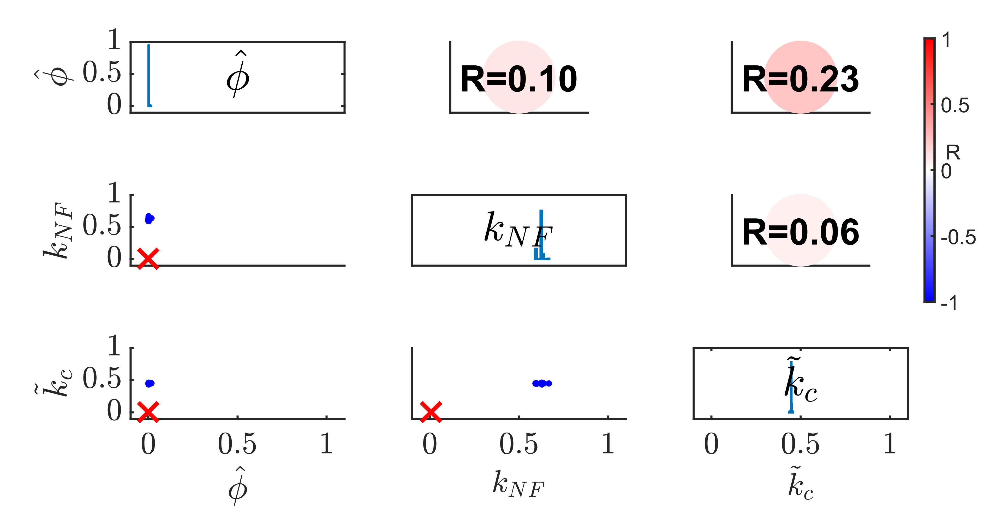
Parameter Retrieval:
Results and Discussion
(a)
(b)
(c)
(d)
6/9

Slide 10
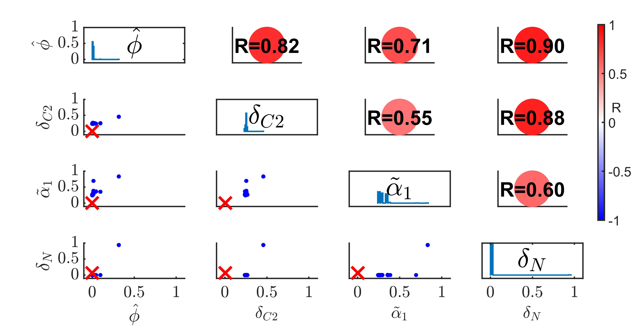
Parameter Identifiability:
Results and Discussion
Parameters resultant in considerably similar model simulation trajectories:
Non-unique
Highly Correlated
7/9

Slide 11
Conclusion
Conclusion and Future Direction
Parameters cannot be retrieved
Existence of non-identifiable parameters
Attributed to model structure or data sparsity
Parameter estimation for the testing model is unlikely to be achieved.
8/9

Slide 12
Future Direction:
Conclusion and Future Direction
Mathematical
Model
Parameter Reduction
Experiment Design
Model Identifiability
Experimental
Data
Fitted Model
Data Sparsity
Parameter Estimation
9/9

Slide 13
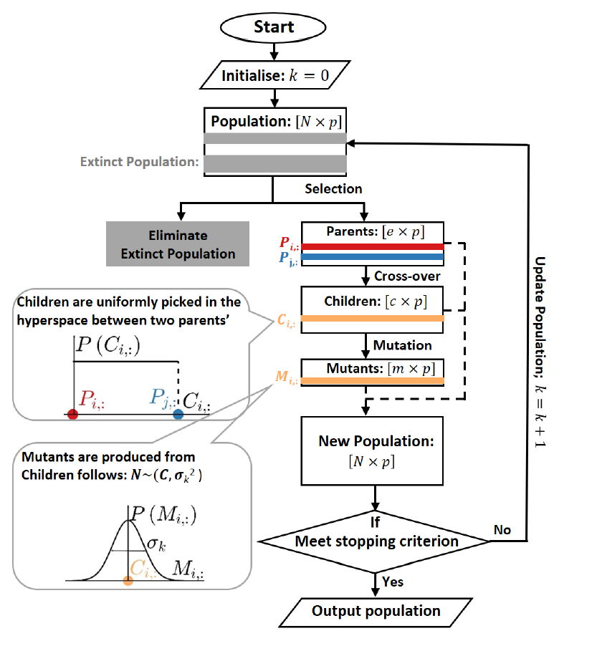
Genetic Algorithm:
Supplementary

Slide 14
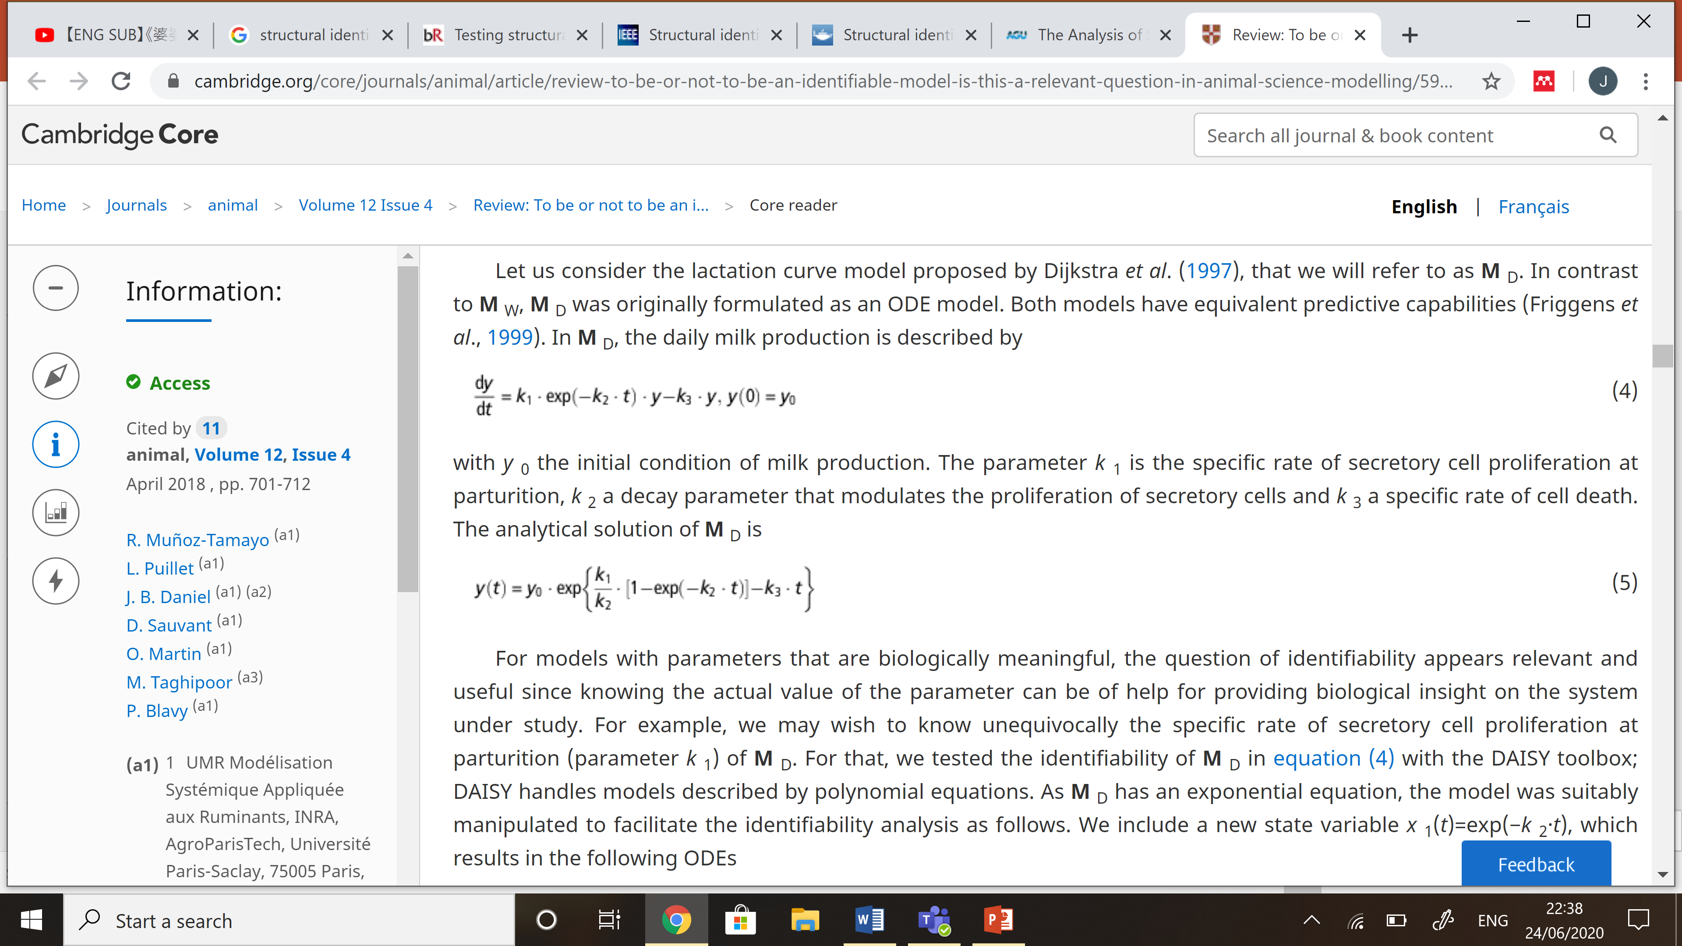
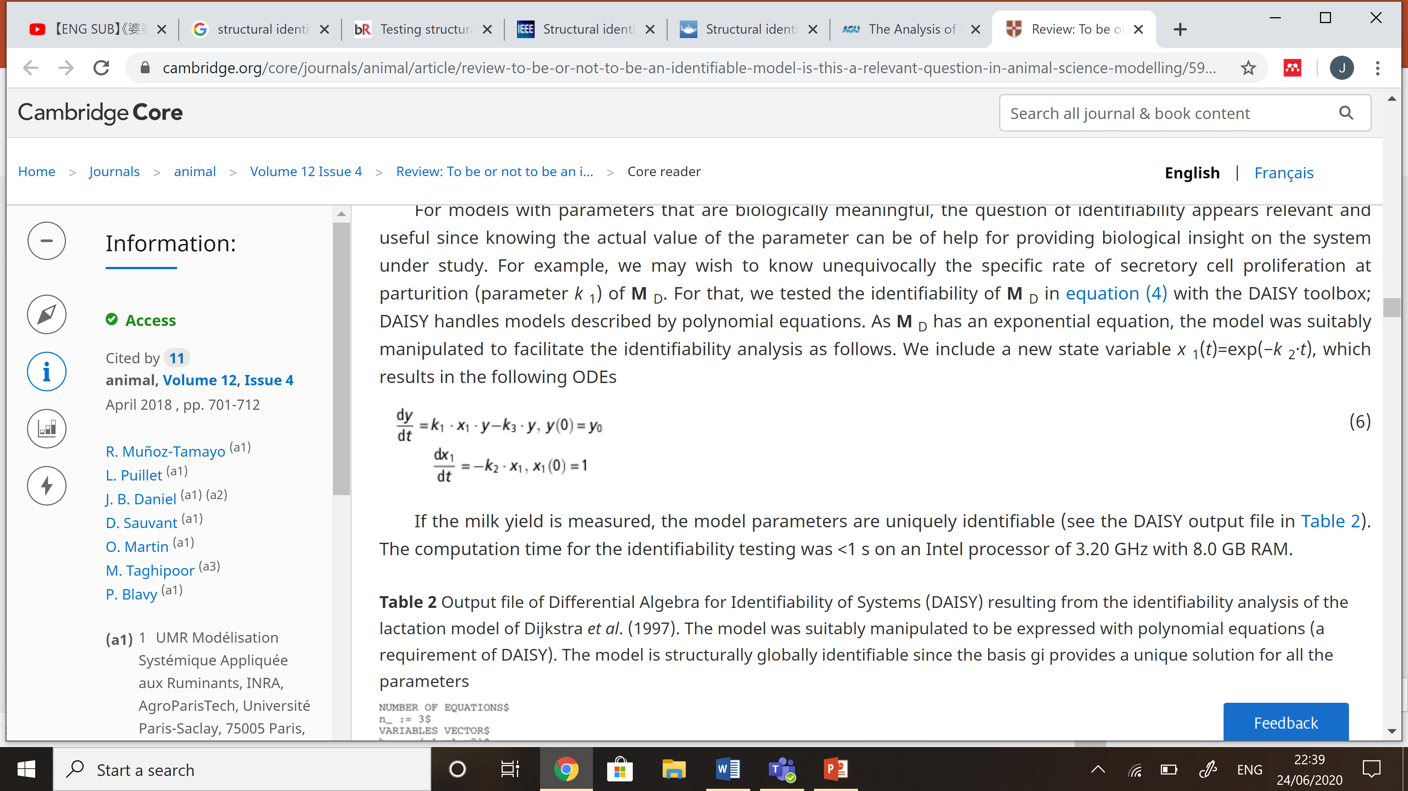
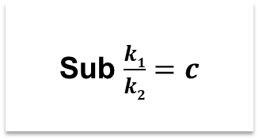
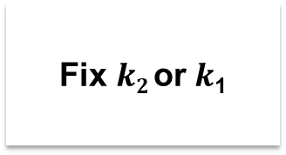
Structural Identifiability:
Supplementary
v
Linear ODE Model:¹
Analytical Solution:
Augment Observable State:²
Parameter Reduction:
Fix $k2$or $k$₁
Sub $\frac{k1}{k2}=c$
Muñoz-Tamayo, R et. al, (2018). Review: To be or not to be an identifiable model. Is this a relevant question in animal science modelling?
Bellu, G et. al. (2007). DAISY: a new software tool to test global identifiability of biological and physiological systems.

Slide 15
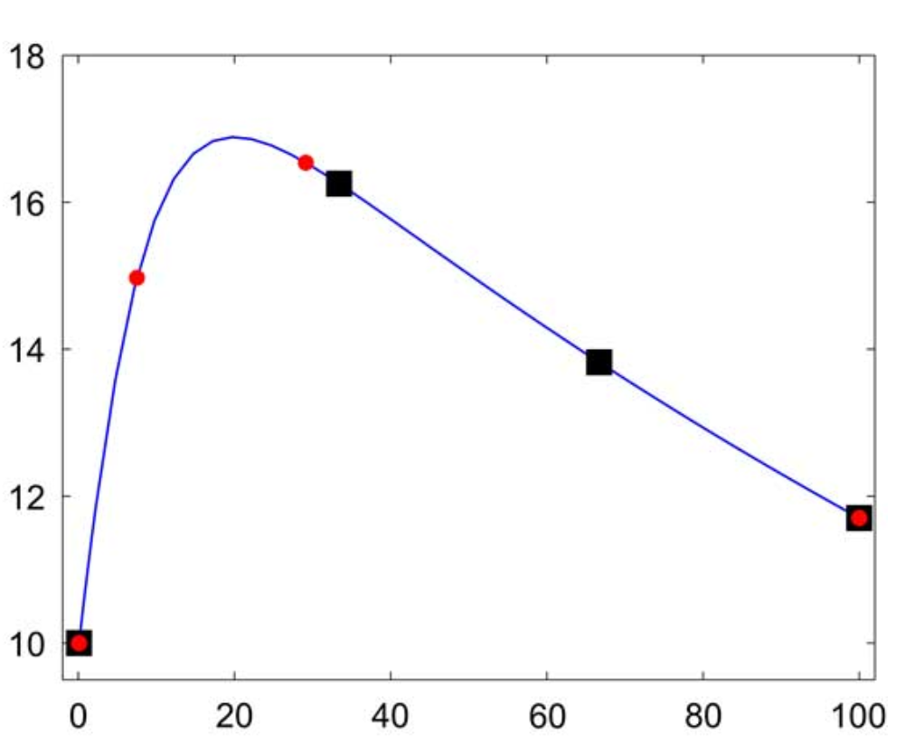
Experiment Design¹:
Supplementary
Parameter Values?
Experiment data:
v
Linear ODE Model:
y
t
Muñoz-Tamayo, R et. al, (2018). Review: To be or not to be an identifiable model. Is this a relevant question in animal science modelling?

Slide 16
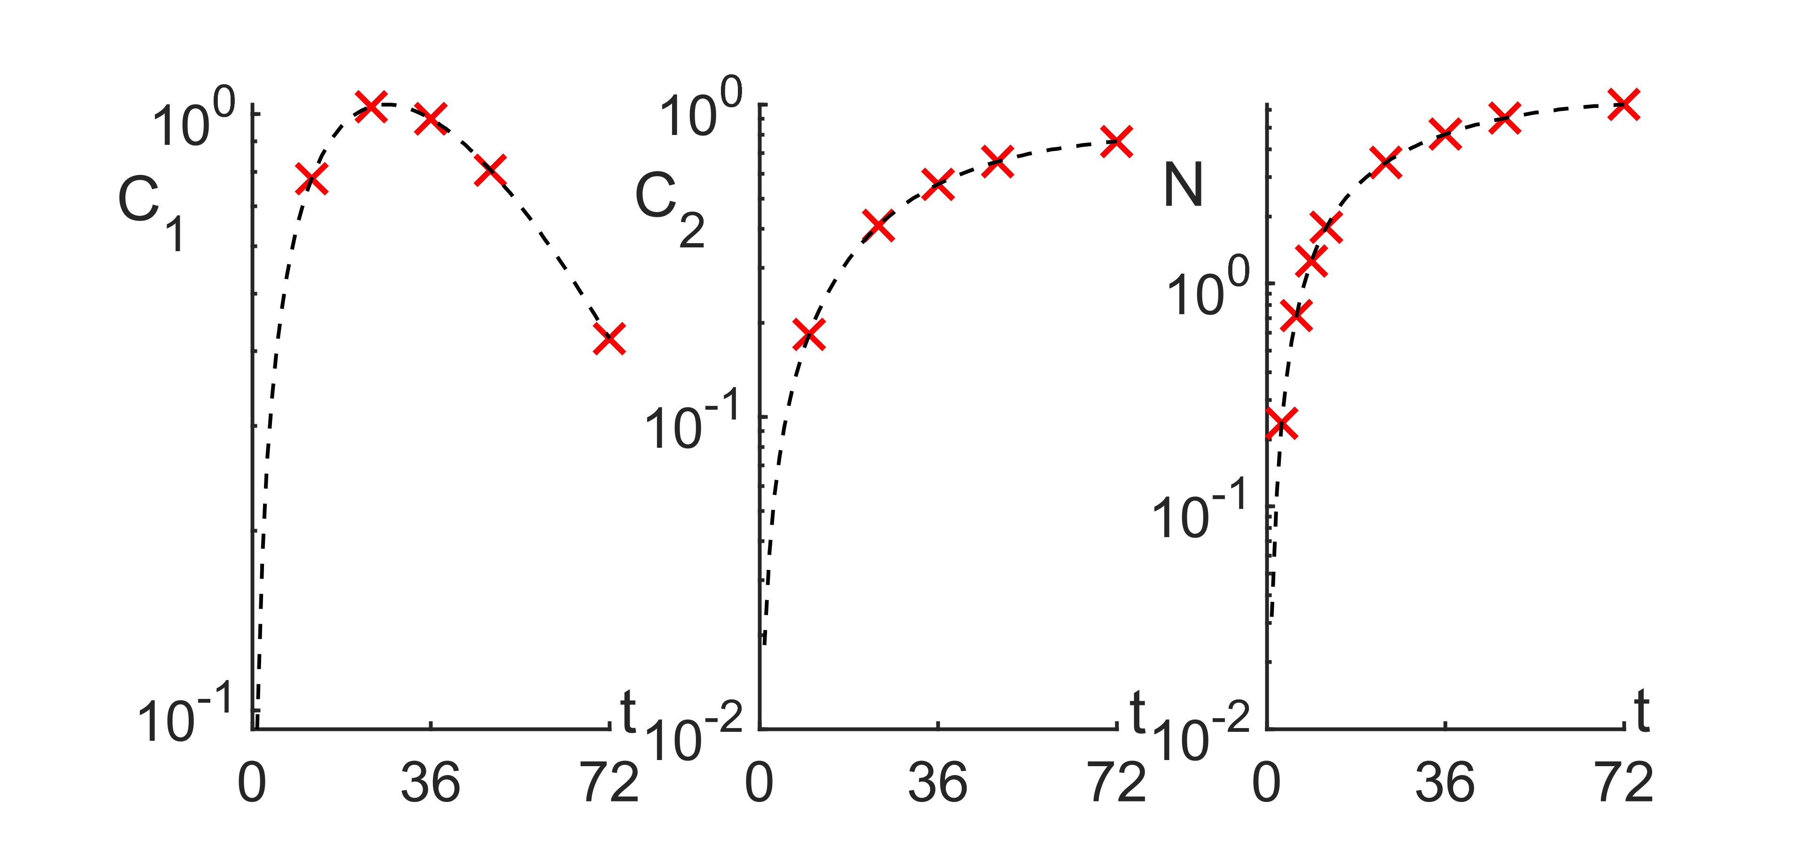
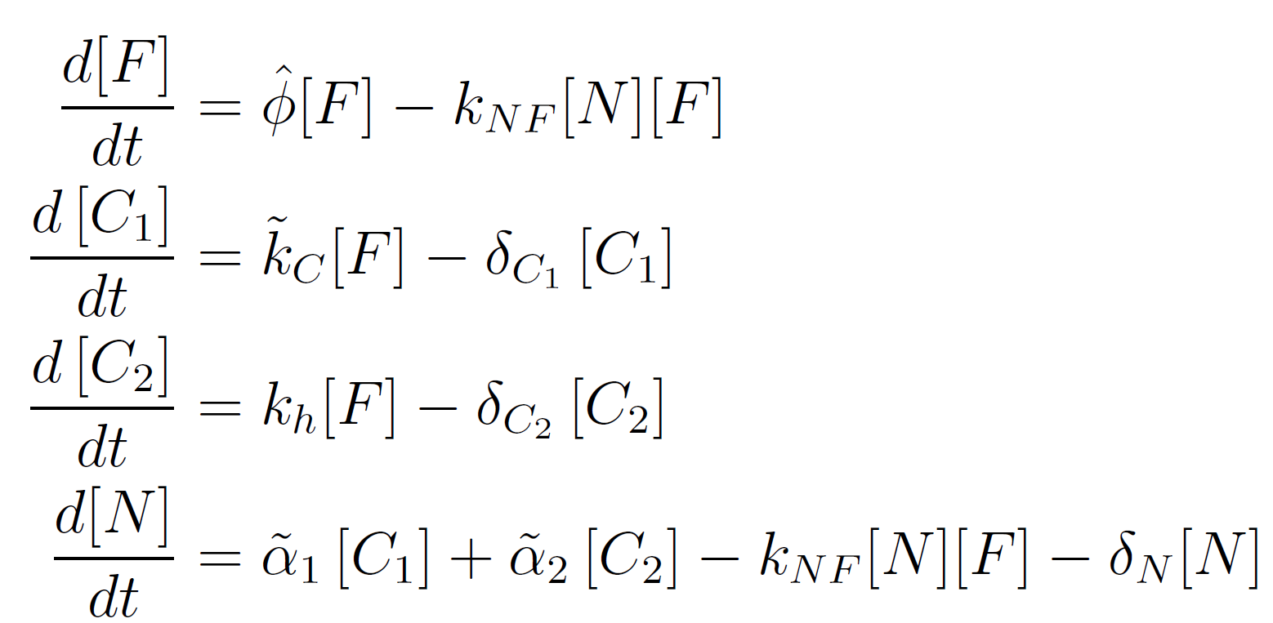
Synthetic Data:
Supplementary-Methodology
Sparsity
Latency
Non-simultaneous Measurements

Slide 17
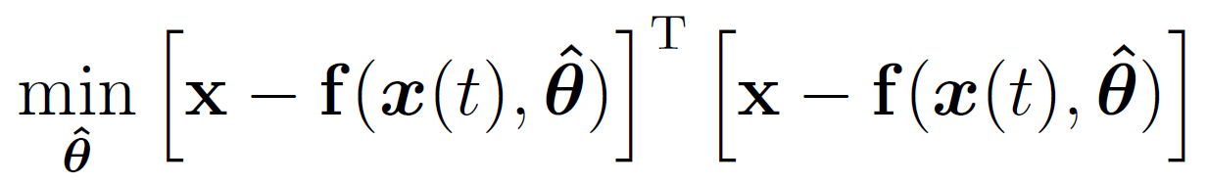
Parameter Estimation Algorithms
Supplementary-Methodology
Fit Model to Data:
Stochastic Global Optimisation
Gradient-Based Local Optimisation

Slide 18
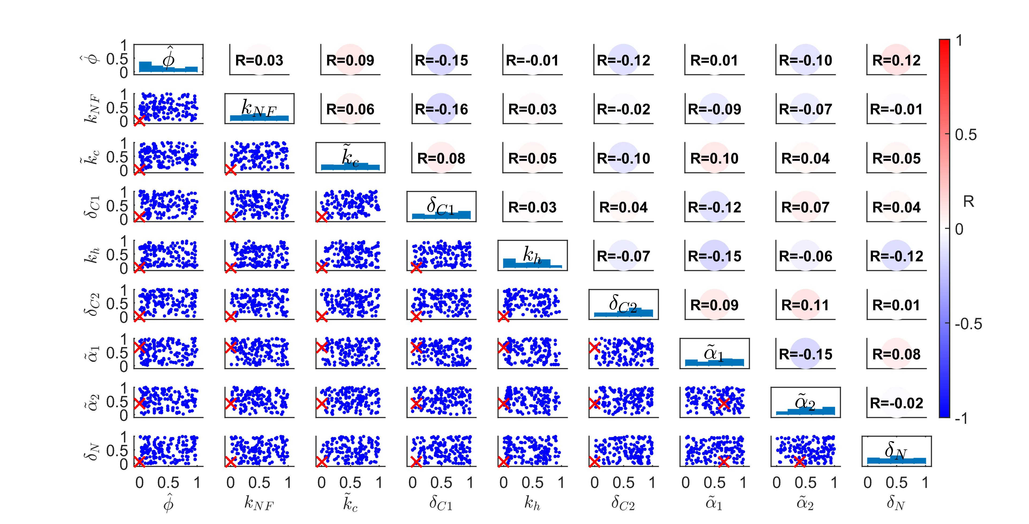
Parameter Retrieval:
Results and Discussion

Slide 19
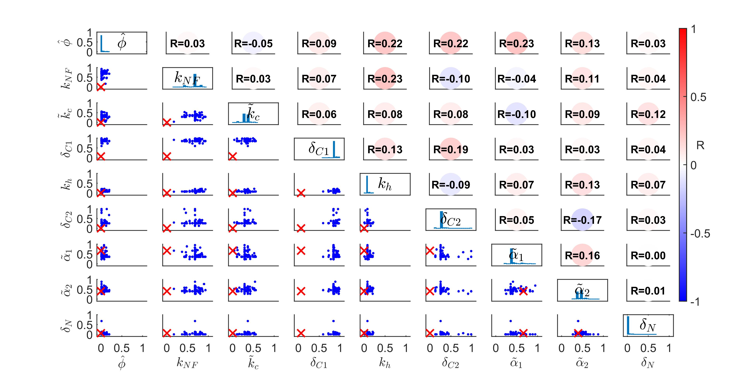
Parameter Retrieval:
Results and Discussion

Slide 20
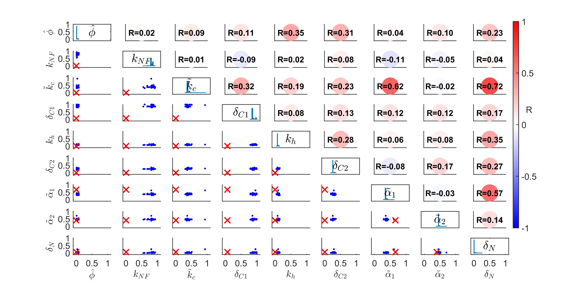
Parameter Retrieval:
Results and Discussion

Slide 21
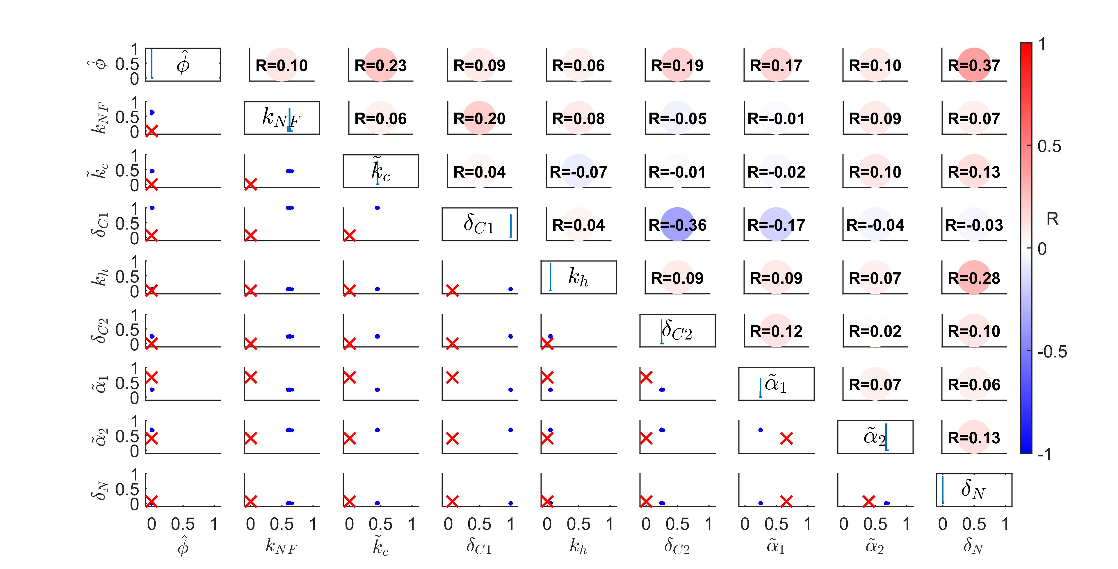
Parameter Retrieval:
Results and Discussion

Slide 22
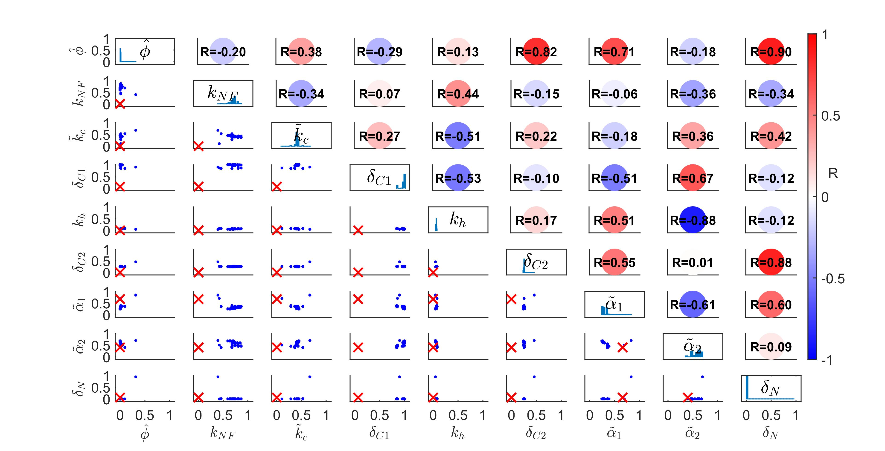
Parameter Identifiability:
Results and Discussion

Slide 23
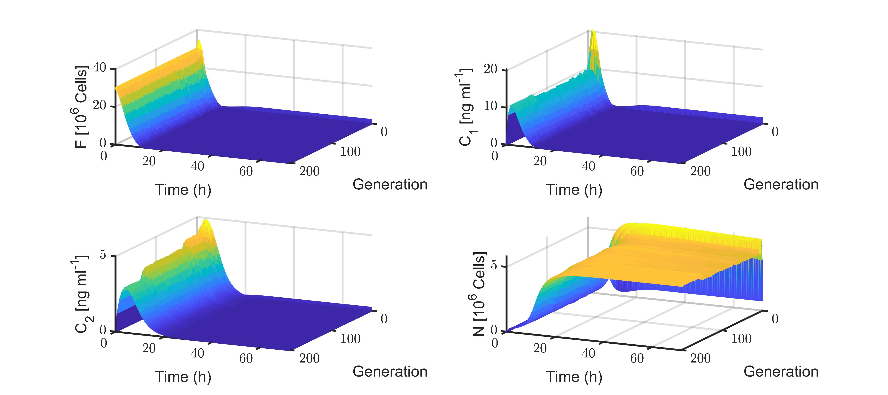
Parameter Identifiability:
Results and Discussion

Slide 24
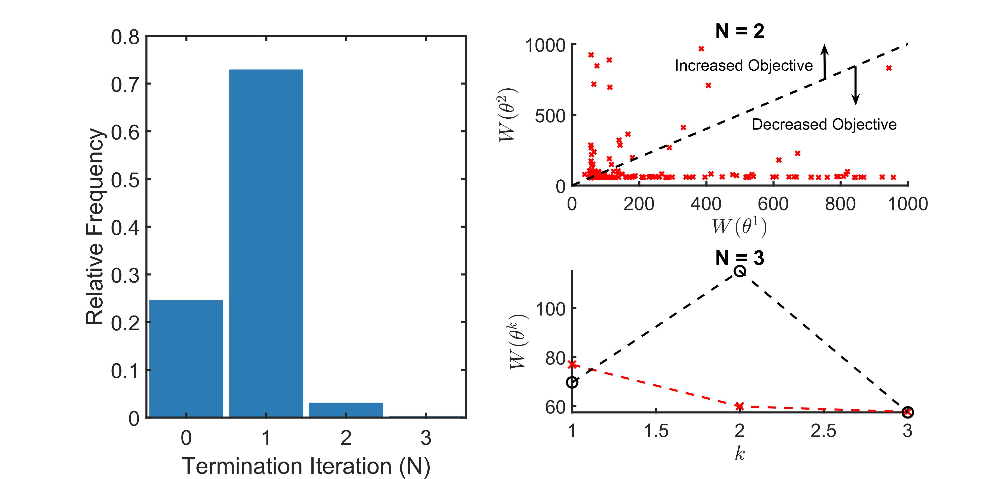
Model Stability:
Results and Discussion
Entering unsolvable region
Unavoidable

Slide 25
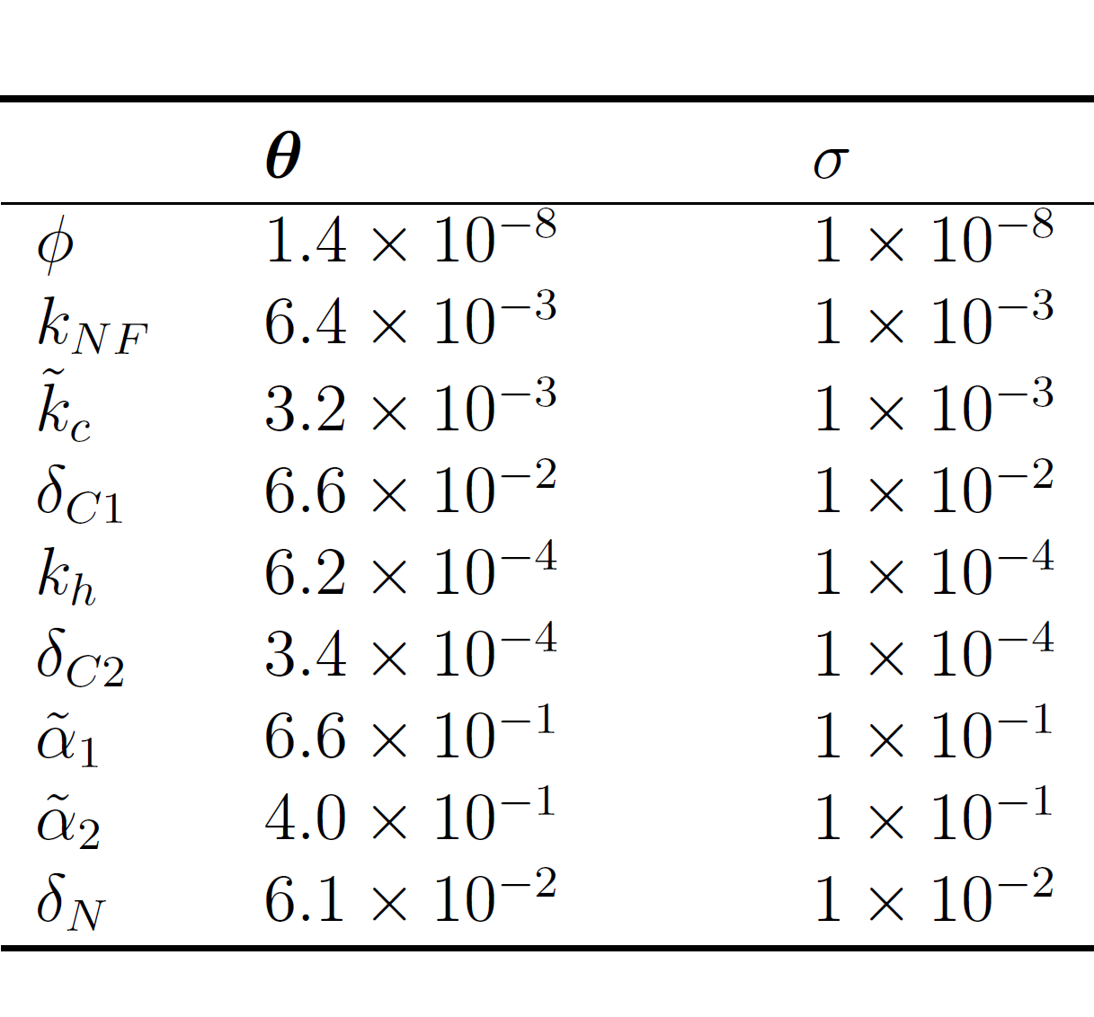
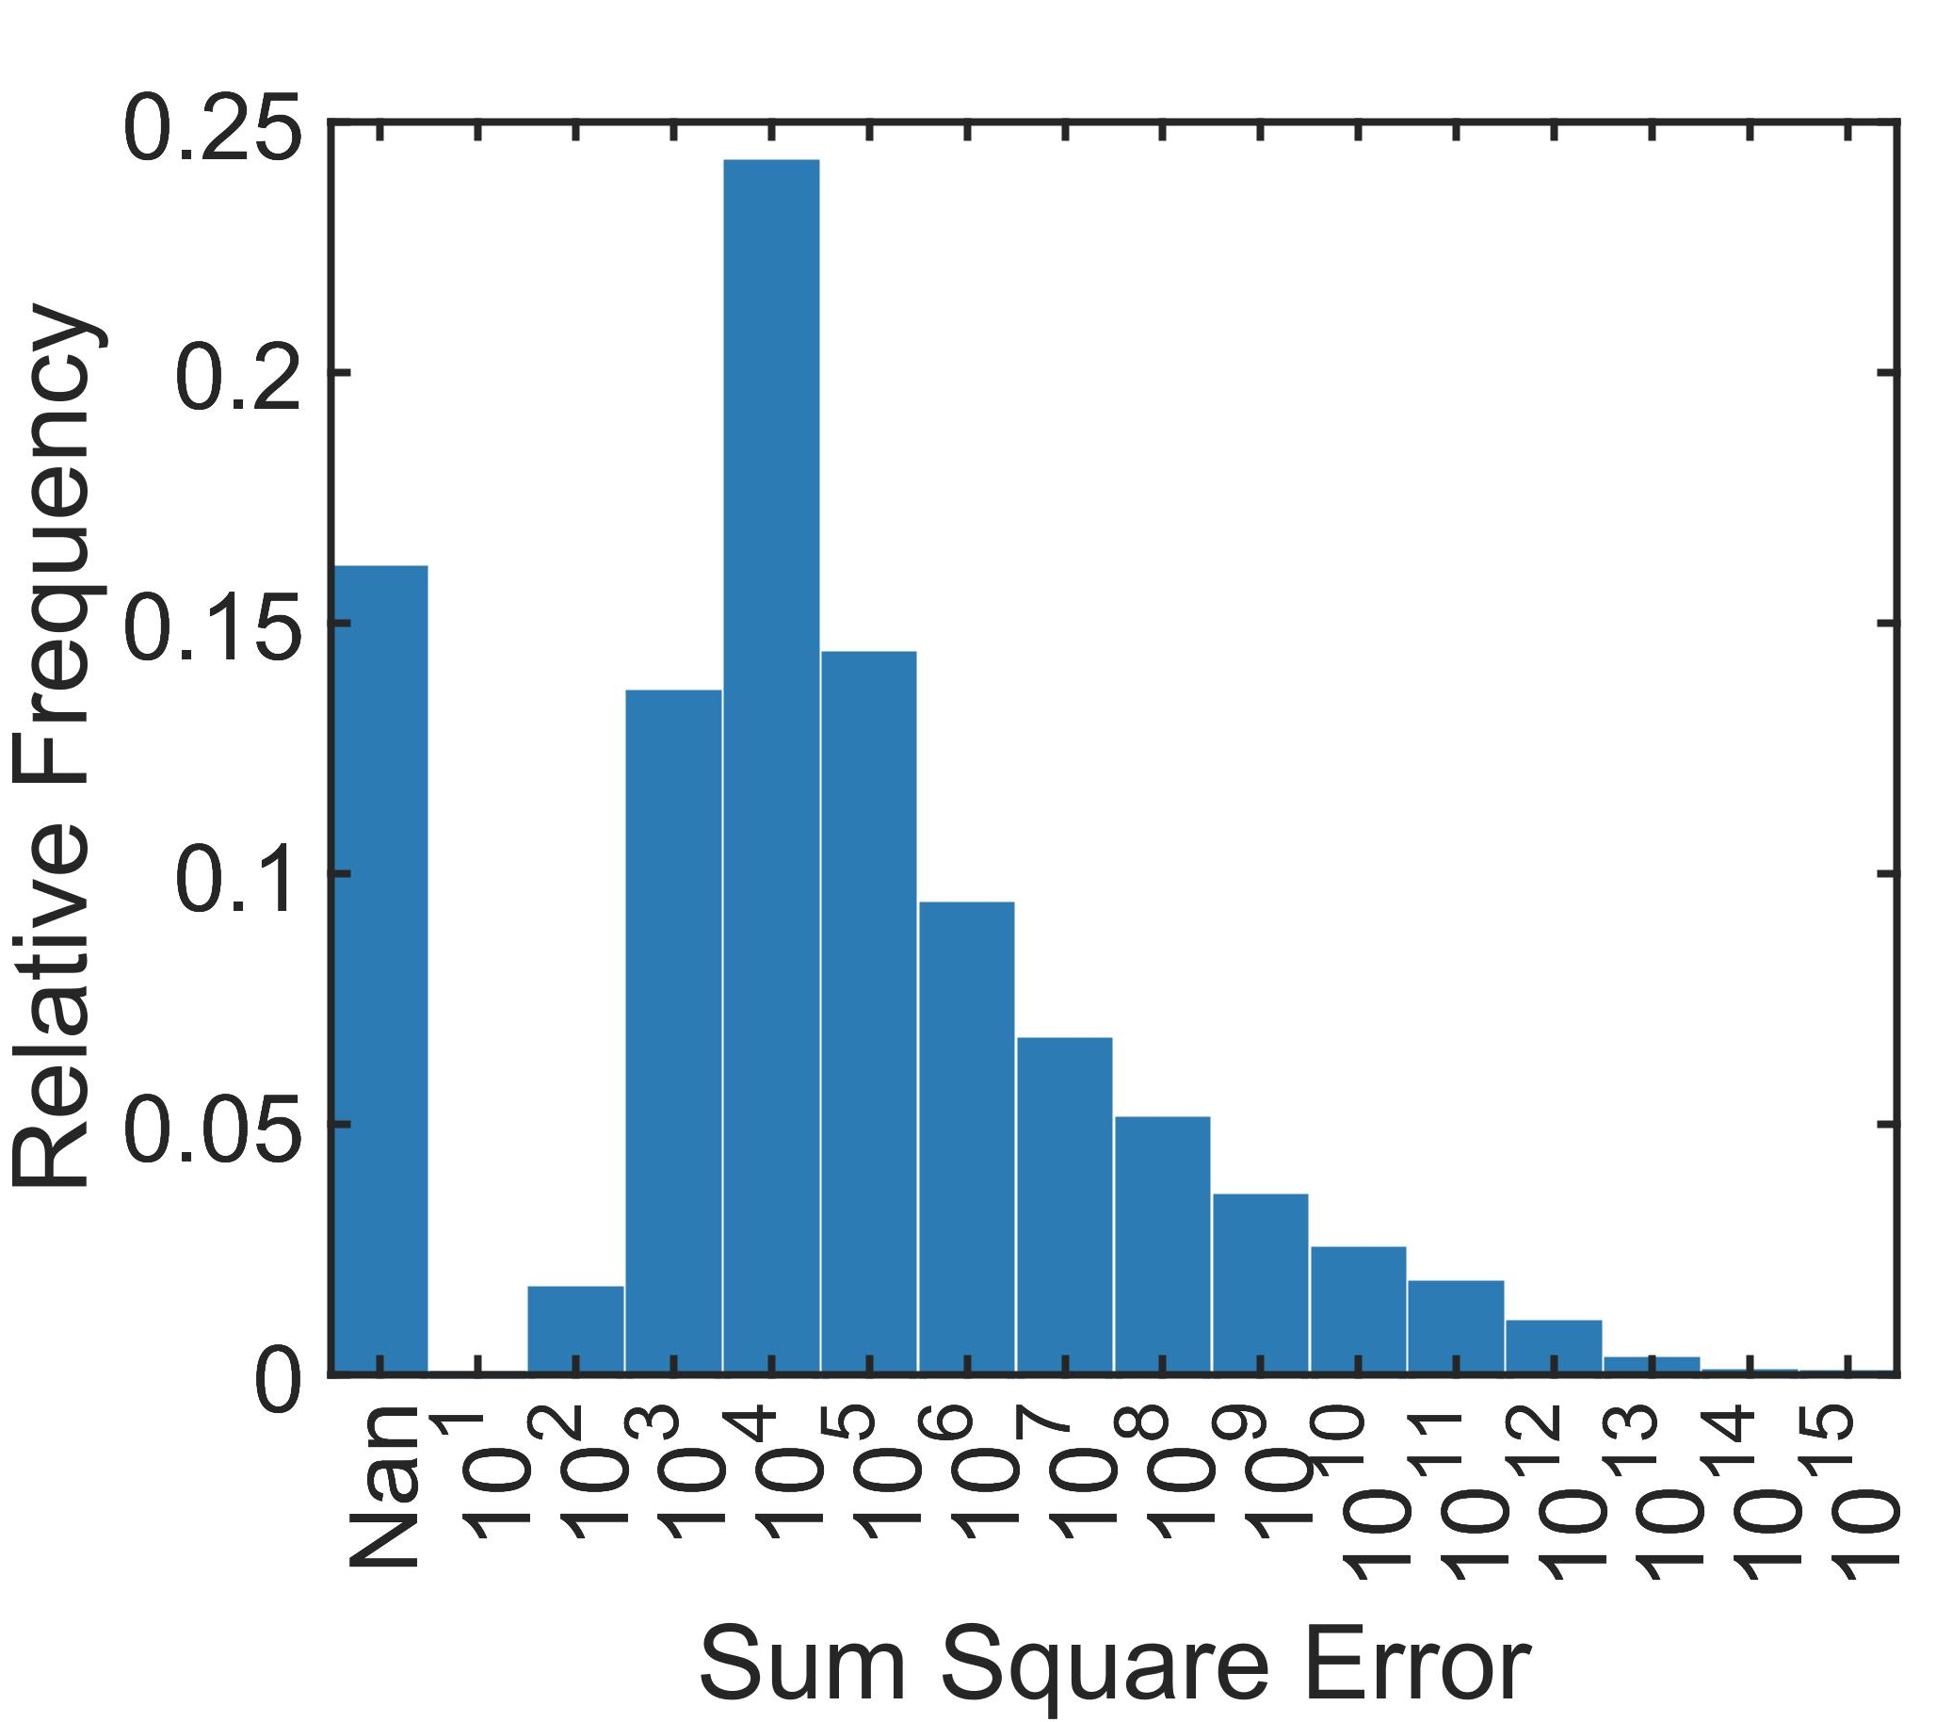
Model Stability:
Results and Discussion

